Slide 1
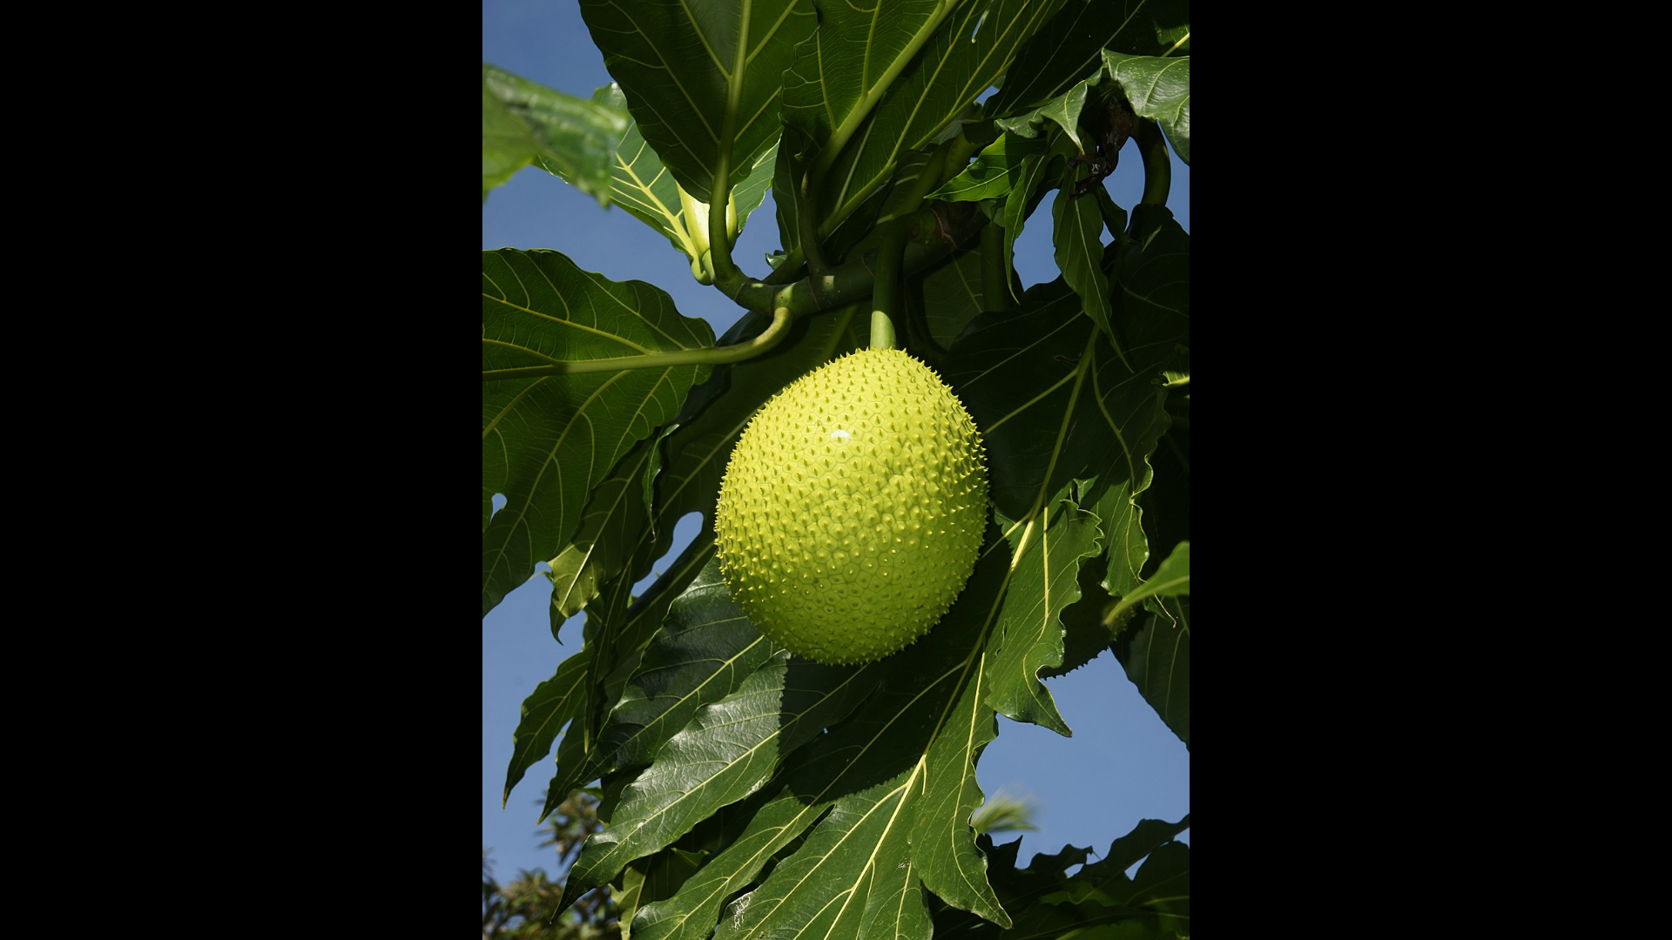


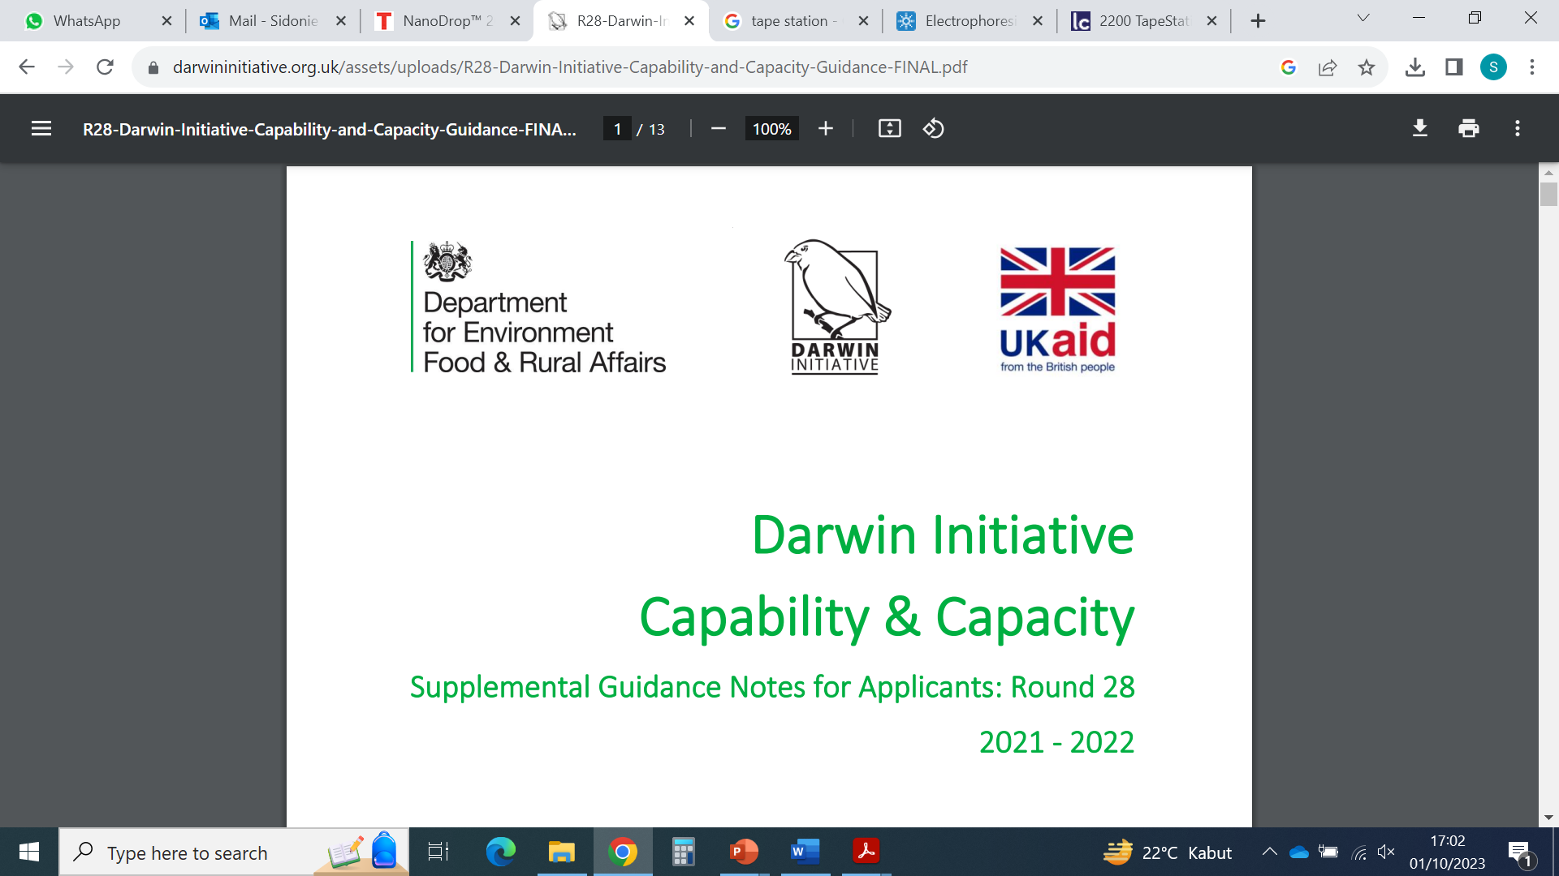
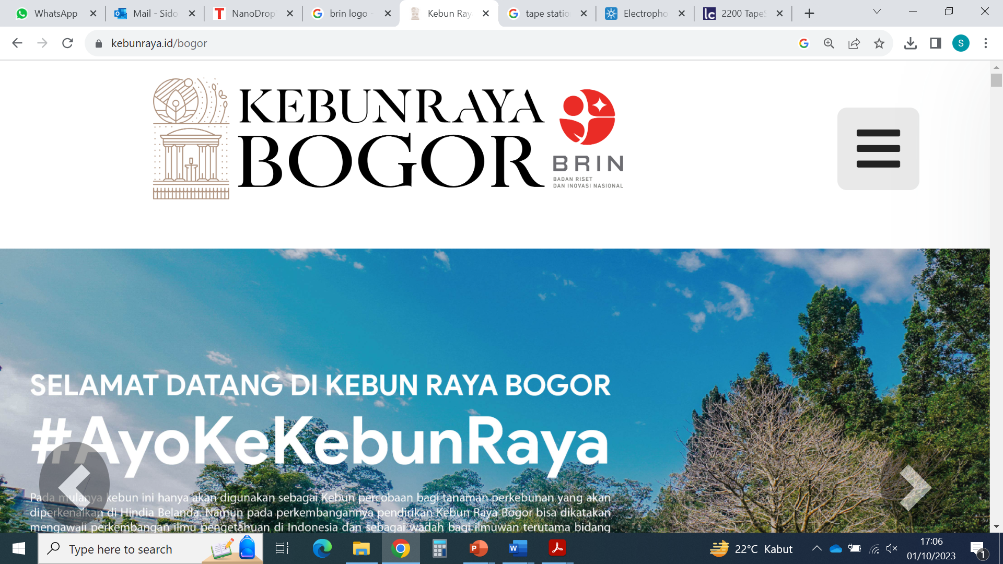
Selamat Datang!
Genomics of Indonesian plants
March 2024 workshop
L. Trethowan
S. Bellot
O. Pérez Escobar
J. Cid
H. Rustiami
M. Ardiyani
…

Slide 2
Day 1
Why this workshop, agenda, Q&A
Coffee break
DNA sequencing challenges
Lunch break
Linux basics

Slide 3
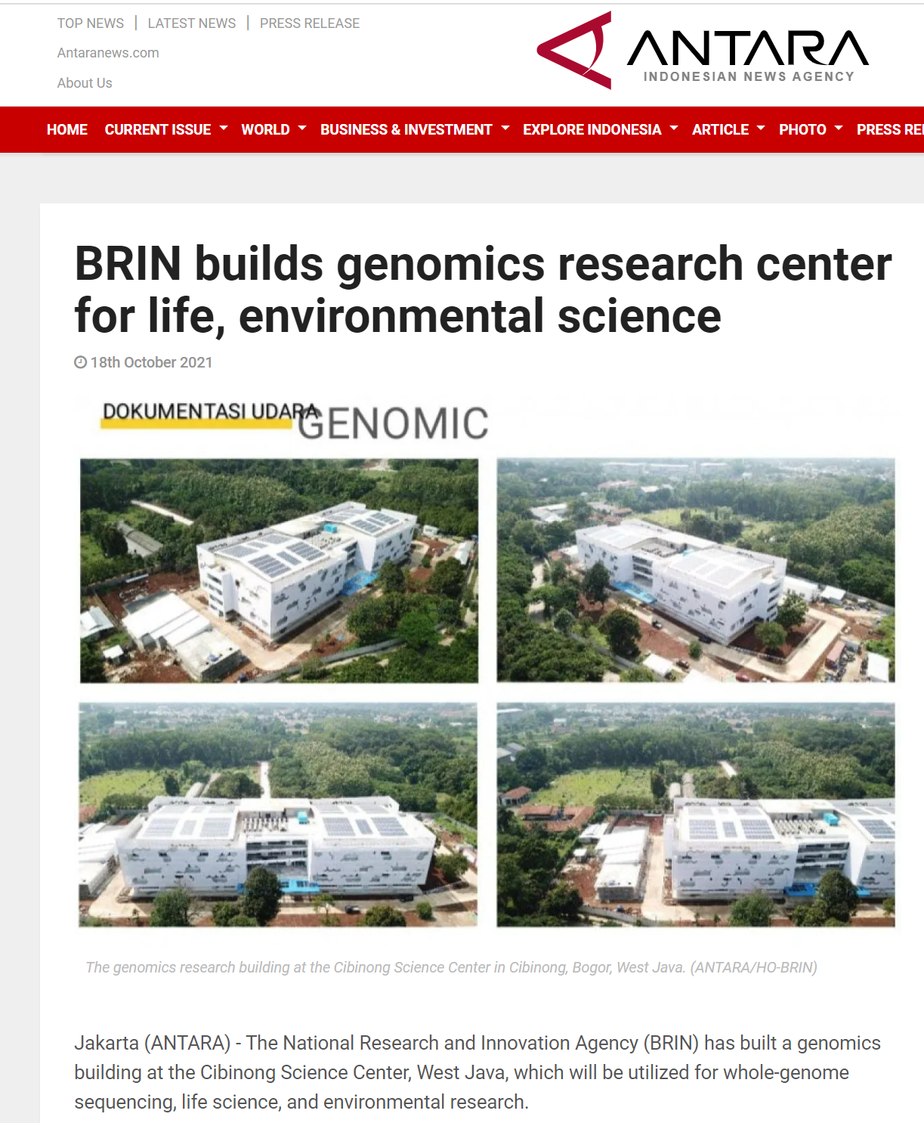
Genomics: the study of genomes
Why do you want to learn genomics?

Slide 4
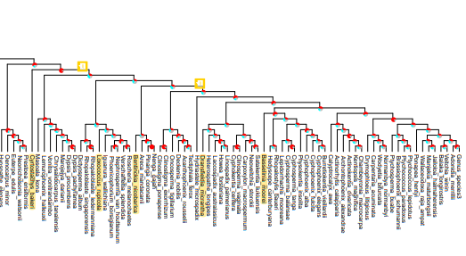
Different goals, different approaches
Phylogenetics, Systematics, Species delimitation
One to many individuals per species
Regions variable but comparable across species/genera
Few to hundreds of regions → species vs gene histories

Slide 5
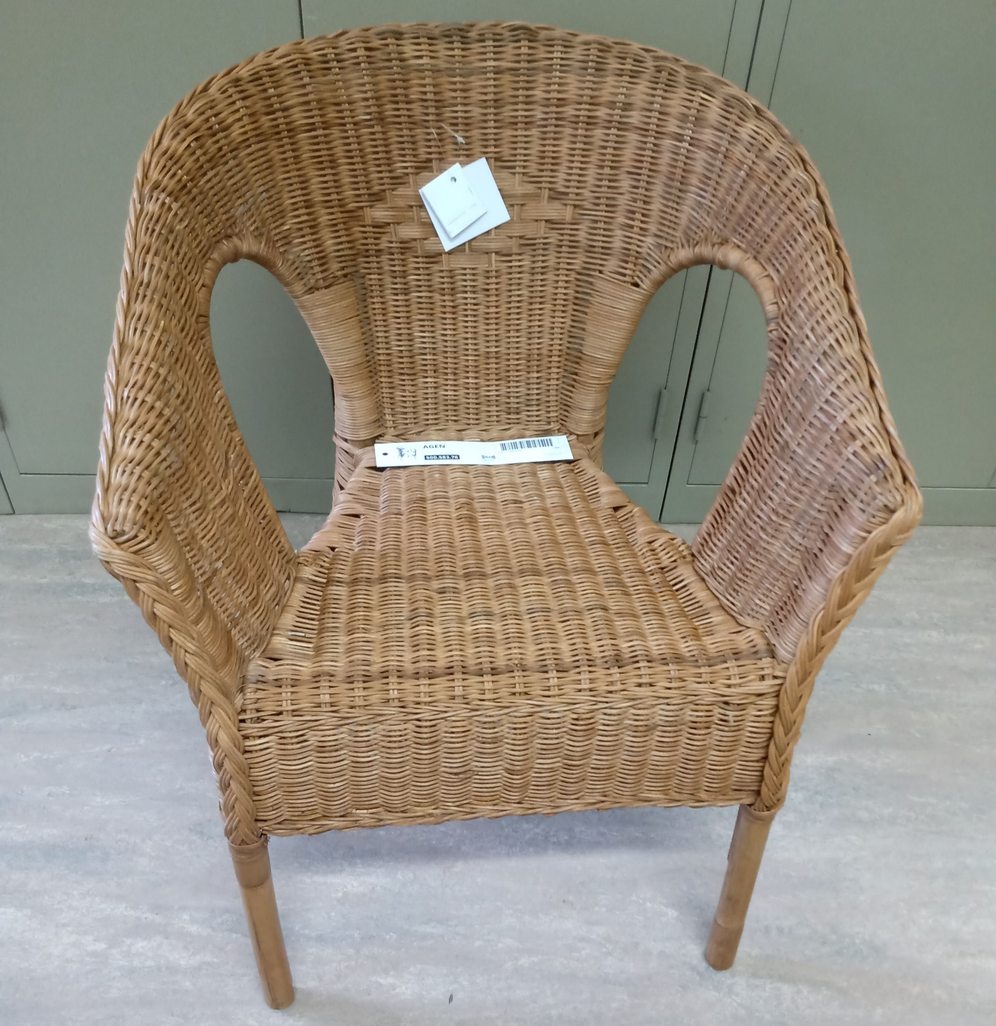
Different goals, different approaches
Phylogenetics, Systematics, Species delimitation
One to many individuals per species
Regions variable but comparable across species/genera
Few to hundreds of regions → species vs gene histories
DNA barcoding, Species identification, Product authentication
Two to many individuals per species (reference data)
Hundreds of samples to identify/authenticate
Regions variable but comparable across species/genera
Few short regions → cheaper for commercial/legal applications

Slide 6
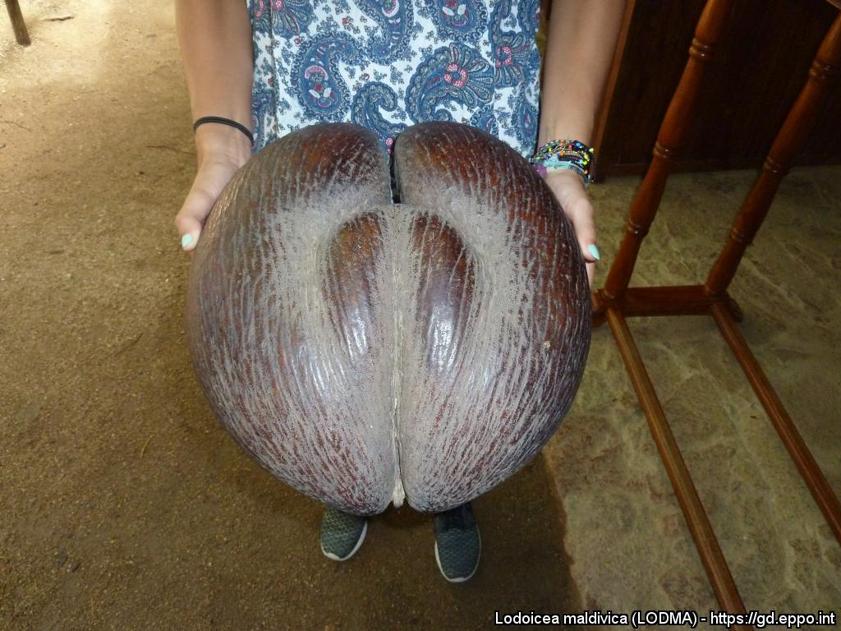
Different goals, different approaches
Phylogenetics, Systematics, Species delimitation
One to many individuals per species
Regions variable but comparable across species/genera
Few to hundreds of regions → species vs gene histories
Identification of genes underpinning important traits
Dozens to hundreds of individuals per species
Whole genomes or Thousands of single nucleotides spread across the genome
A genome of reference is helpful
DNA barcoding, Species identification, Product authentication
Two to many individuals per species (reference data)
Hundreds of samples to identify/authenticate
Regions variable but comparable across species/genera
Few short regions → cheaper for commercial/legal applications

Slide 7
Many labwork and analysis steps are similar across
different types of plant genomic studies
Common themes:
DNA extraction
DNA preparation
DNA sequencing
DNA data formats
DNA data cleaning
DNA data assembly
DNA analysis

Slide 8
Many labwork and analysis steps are similar across
different types of plant genomic studies
Common themes:
DNA extraction
DNA preparation
DNA sequencing
DNA data formats
DNA data cleaning
DNA data assembly
DNA analysis
Variations:
Short vs long DNA, Few vs lots of DNA

Slide 9
Many labwork and analysis steps are similar across
different types of plant genomic studies
Common themes:
DNA extraction
DNA preparation
DNA sequencing
DNA data formats
DNA data cleaning
DNA data assembly
DNA analysis
Variations:
Short vs long DNA, Few vs lots of DNA
Capture of target regions or not

Slide 10
Many labwork and analysis steps are similar across
different types of plant genomic studies
Common themes:
DNA extraction
DNA preparation
DNA sequencing
DNA data formats
DNA data cleaning
DNA data assembly
DNA analysis
Variations:
Short vs long DNA, Few vs lots of DNA
Capture of target regions or not
Long vs short reads

Slide 11
Many labwork and analysis steps are similar across
different types of plant genomic studies
Common themes:
DNA extraction
DNA preparation
DNA sequencing
DNA data formats
DNA data cleaning
DNA data assembly
DNA analysis
Variations:
Short vs long DNA, Few vs lots of DNA
Capture of target regions or not
Long vs short reads
Fastq vs Fast5

Slide 12
Many labwork and analysis steps are similar across
different types of plant genomic studies
Common themes:
DNA extraction
DNA preparation
DNA sequencing
DNA data formats
DNA data cleaning
DNA data assembly
DNA analysis
Variations:
Short vs long DNA, Few vs lots of DNA
Capture of target regions or not
Long vs short reads
Fastq vs Fast5
Different adapters to remove, different error correction and quality filtering thresholds

Slide 13
Many labwork and analysis steps are similar across
different types of plant genomic studies
Common themes:
DNA extraction
DNA preparation
DNA sequencing
DNA data formats
DNA data cleaning
DNA data assembly
DNA analysis
Variations:
Short vs long DNA, Few vs lots of DNA
Capture of target regions or not
Long vs short reads
Fastq vs Fast5
Different adapters to remove, different error correction and quality filtering thresholds
Reference genome or not, Single nucleotides vs whole DNA regions

Slide 14
Many labwork and analysis steps are similar across
different types of plant genomic studies
Common themes:
DNA extraction
DNA preparation
DNA sequencing
DNA data formats
DNA data cleaning
DNA data assembly
DNA analysis
Variations:
Short vs long DNA, Few vs lots of DNA
Capture of target regions or not
Long vs short reads
Fastq vs Fast5
Different adapters to remove, different error correction and quality filtering thresholds
Reference genome or not, Single nucleotides vs whole DNA regions
Phylogenies, summary statistics, DNA comparisons, demographic and selection patterns

Slide 15
Many labwork and analysis steps are similar across
different types of plant genomic studies
Common themes:
DNA extraction
DNA preparation
DNA sequencing
DNA data formats
DNA data cleaning
DNA data assembly
DNA analysis
Variations:
In this workshop, we will focus on what is common to all approaches but also highlight
the main variations
and provide links to open-access tutorials for what we cannot cover
Short vs long DNA, Few vs lots of DNA
Capture of target regions or not
Long vs short reads
Fastq vs Fast5
Different adapters to remove, different error correction and quality filtering thresholds
Reference genome or not, Single nucleotides vs whole DNA regions
Phylogenies, summary statistics, DNA comparisons, demographic and selection patterns

Slide 16
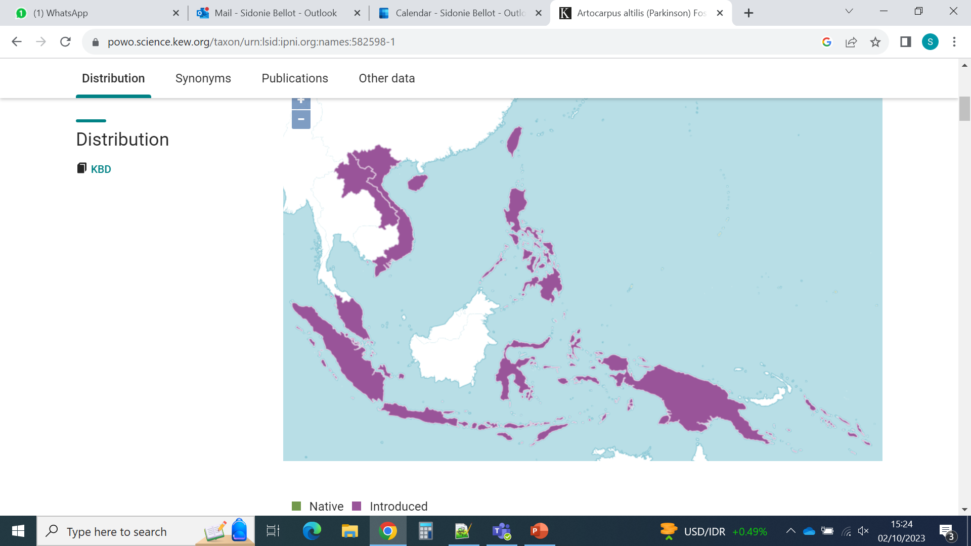
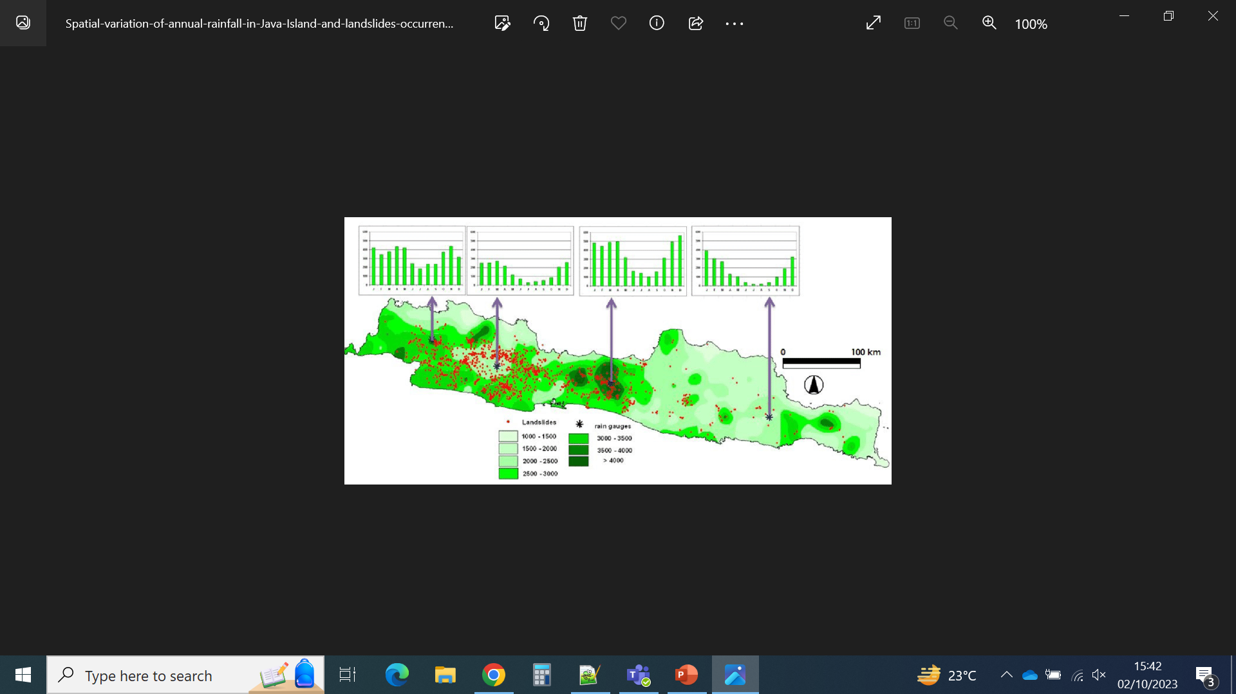
Case study: did breadfruit develop genetic adaptations to local climates?
Artocarpus altilis
distribution
(introduced)
https://powo.science.kew.org/
Rainfall variation in Java
Hadmoko et al., 2017, Forum Geografi 31

Slide 17
Case study: did breadfruit develop genetic adaptations to local climates?
Project
Compare the genomes of breadfruit from drier and wetter places
to see if we find genetic differences correlated with climate

Slide 18
Case study: did breadfruit develop genetic adaptations to local climates?
Project
Compare the genomes of breadfruit from drier and wetter places
to see if we find genetic differences correlated with climate
Samples available
Wetter climate: West Java (12 samples)
Drier climate: East Java (12 samples)

Slide 19
Case study: did breadfruit develop genetic adaptations to local climates?
Project
Compare the genomes of breadfruit from drier and wetter places
to see if we find genetic differences correlated with climate
Samples available
Wetter climate: West Java (12 samples)
Drier climate: East Java (12 samples)
Strategy
Produce a draft genome with short + long reads (1 sample from wet place + 1 sample from drier place)
Produce short read data for the 22 other samples
Compare the data from the 22 samples, with the help of the reference genomes

Slide 20
Case study: did breadfruit develop genetic adaptations to local climates?
Project
Compare the genomes of breadfruit from drier and wetter places
to see if we find genetic differences correlated with climate
Samples available
Wetter climate: West Java (12 samples)
Drier climate: East Java (12 samples)
Strategy
Produce a draft genome with short + long reads (1 sample from wet place + 1 sample from drier place)
Produce short read data for the 22 other samples
Compare the data from the 22 samples, with the help of the reference genomes
Outcomes
There is not enough statistical power to detect local adaptation, but it is enough for a pilot to get more $$$
The genomes and preliminary results can be published
The data can be used for other applications (DNA barcoding, phylogenetics, demography studies…)

Slide 21
Week 1
Day 3
ONT (minion) sequencing
Coffee break
Choosing the right sequencing approach
Breadfruit project
Lunch break
Illumina data format
Day 1
Why this workshop, agenda, Q&A
Coffee break
DNA sequencing challenges
Lunch break
Linux environment and basic commands
Day 4
Illumina data quality analysis
Lunch break
Illumina data cleaning
Day 2
DNA sequencing and coverage
Coffee break
Illumina sequencing
Lunch break
More linux
Day 5
Phylogenomics

Slide 22
Week 2 (preliminary)
Day 1/2
ONT (minion) data cleaning and analysis
Assembling a genome using minion data
Day 2/3
Working on a HPC
Population genetics basics
Read mapping and quality filtering for pop gen
Day 4/5
Population structure analyses
Day 5
Introduction to landscape genomics?

Slide 23
Questions, Suggestions?

Slide 24
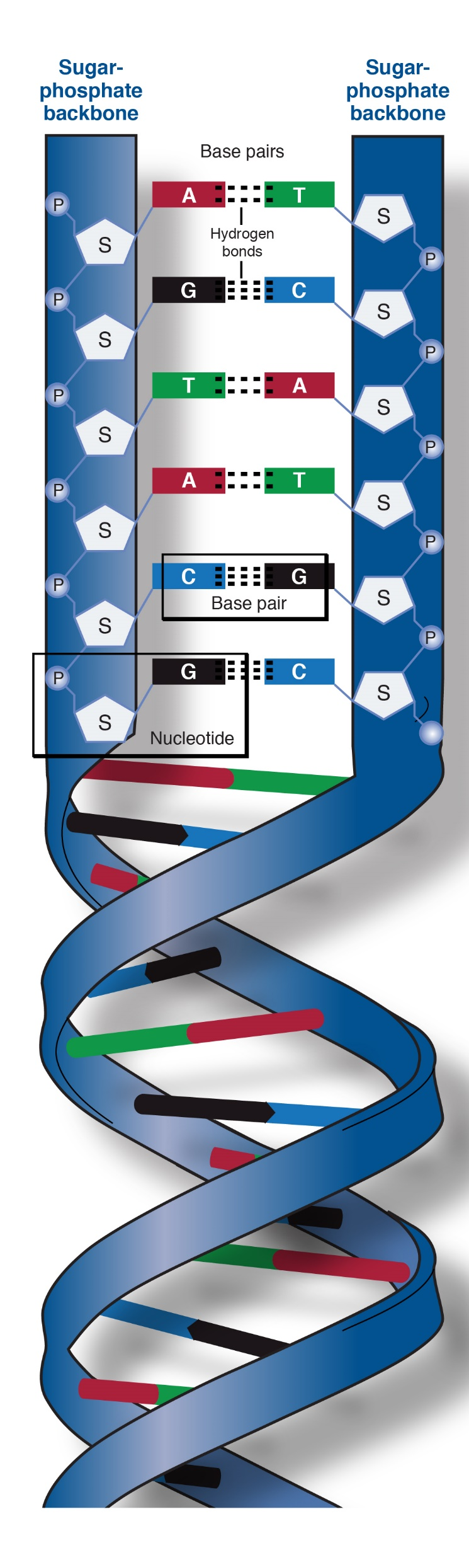
DNA
1 base ~ 1 nucleotide
2 DNA strands
1 base pair
(bp)
TACGAAACGGTATCATGGTAAATCGTTTTGGGTACTGAAGCCCGGGTTACGTAGAT
…
ATGCTTTGCCATAGTACCATTTAGCAAAACCCATGACTTCGGGCCCAATGCATCTA
Symbolic representation in following slides
Wikipedia

Slide 25

ATGCTTTGCCATAGTACCATTTAGCAAAACCCATGACTTCTTTTTTGCAAAAGGGCCCAATGCATCTA
DNA region to sequence
DNA
sequencing
DNA fragments
(naturally degraded or fragmented on purpose)
TGCCATAGTACCATTT
TTGCAAAAGG
ATGCTTTGCCATAG
AAGGGCCCAATGCATCTA
DNA data = DNA sequences
= sequencing reads = reads
ACCATTTAGCAAAAC
CTTCTTTTTTGCAA

Slide 26

ATGCTTTGCCATAGTACCATTTAGCAAAACCCATGACTTCTTTTTTGCAAAAGGGCCCAATGCATCTA
DNA region to sequence
DNA
sequencing
DNA fragments
(naturally degraded or fragmented on purpose)
TGCCATAGTACCATTT
TTGCAAAAGG
ATGCTTTGCCATAG
AAGGGCCCAATGCATCTA
DNA data = DNA sequences
= sequencing reads = reads
ACCATTTAGCAAAAC
CTTCTTTTTTGCAA
ATGCTTTGCCATAGTACCATTTAGCAAAACCCATGACTTCTTTTTTGCAAAAGGGCCCAATGCATCTA
Reference region (optional)
DNA data
assembly
ATGCTTTGCCATAG
CTTCTTTTTTGCAA
TGCCATAGTACCATTT
TTGCAAAAGG
Assembly process
= read mapping
ACCATTTAGCAAAAC
AAGGGCCCAATGCATCTA
ATGCTTTGCCATAGTACCATTTAGCAAAAC
CTTCTTTTTTGCAAAAGGGCCCAATGCATCTA
Assembled DNA regions
= contigs
ATGCTTTGCCATAGTACCATTTAGCAAAACNNNNNNCTTCTTTTTTGCAAAAGGGCCCAATGCATCTA
Concatenated contigs
= scaffolds

Slide 27
Challenges of DNA sequencing and genome assembly
Big genomes
Heterozygous genomes
Polyploid genomes
Repeated DNA

Slide 28
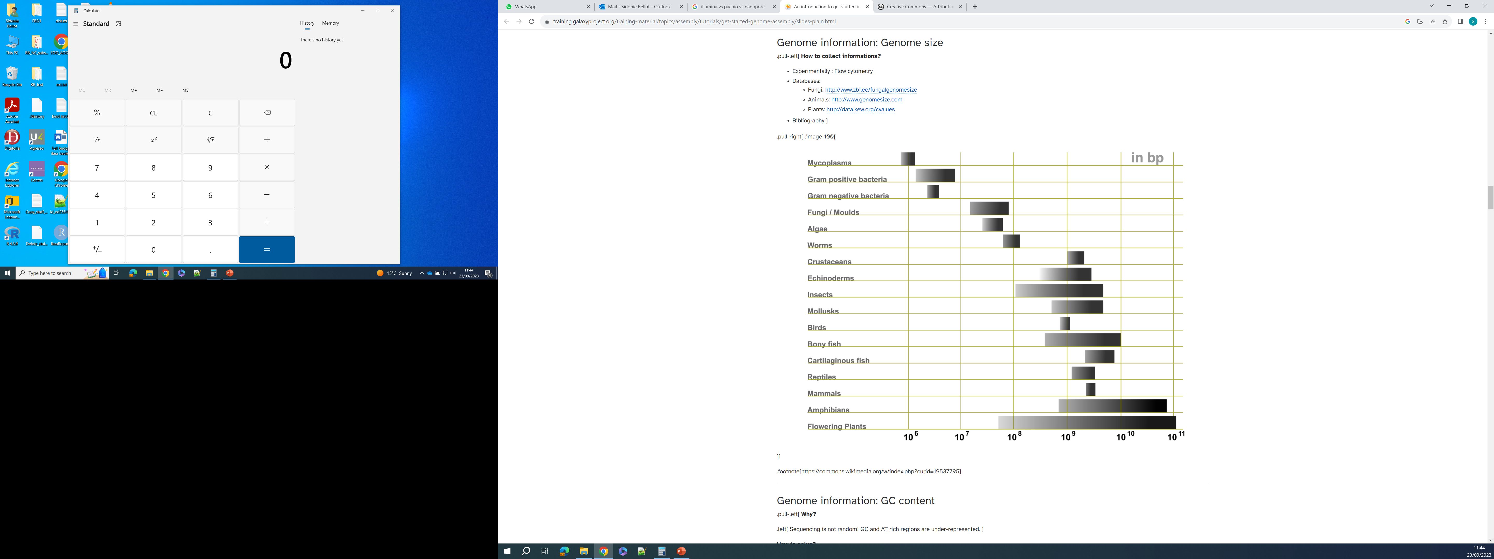

Big genomes: more data = more money needed
Human genome:
3 000 000 000 bp
(3 Gbp)
Plant genomes can be tiny or giant!
12 000 000 – 148 000 000 000 bp (0.012 – 148 Giga bp)
© Adapted from Galaxy Training Network, Cormier, Leroi et al., 2023, licensed under Creative Commons Attribution 4.0 International License

Slide 29
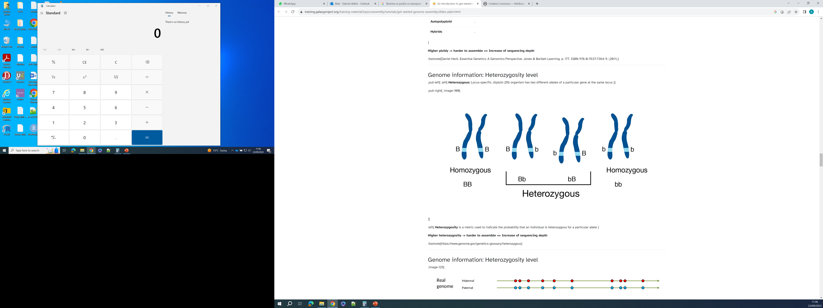
Heterozygous genomes: how to distinguish haplotypes?
Heterozygous locus:
Region with two different alleles
© Adapted from Galaxy Training Network, Cormier, Leroi et al., 2023, licensed under Creative Commons Attribution 4.0 International License

Slide 30
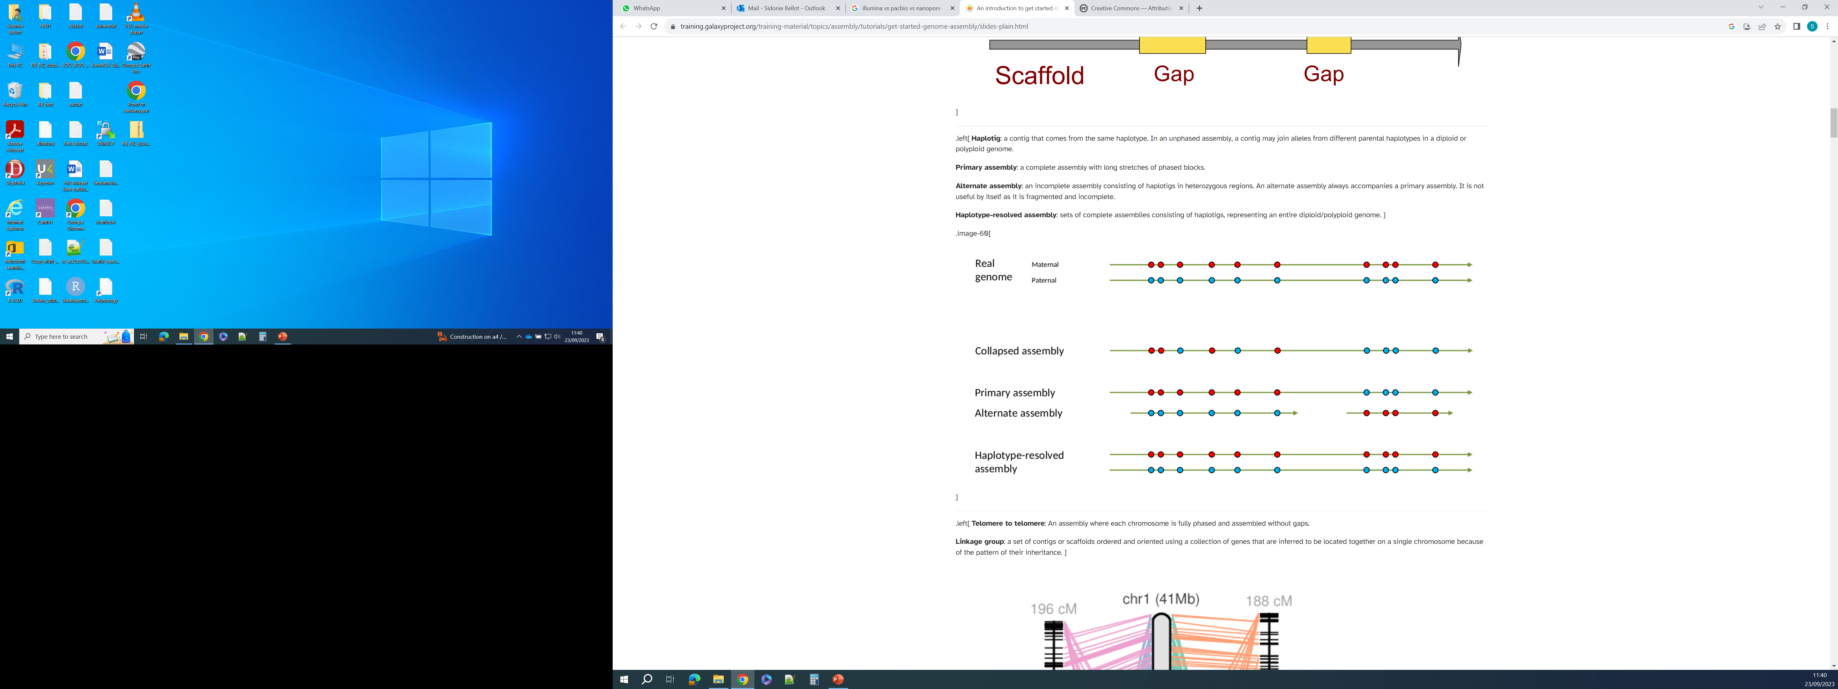
Heterozygous genomes: how to distinguish haplotypes?
Paternal chromosome
Maternal chromosome
Sequencing reads from fragmented DNA
Heterozygous locus:
Region with two different alleles
When many nucleotide sites are heterozygous, it can be difficult to “resolve the haplotypes”, i.e. to know what alleles of the different sites are on the same chromosome
© Adapted from Galaxy Training Network, Cormier, Leroi et al., 2023, licensed under Creative Commons Attribution 4.0 International License

Slide 31
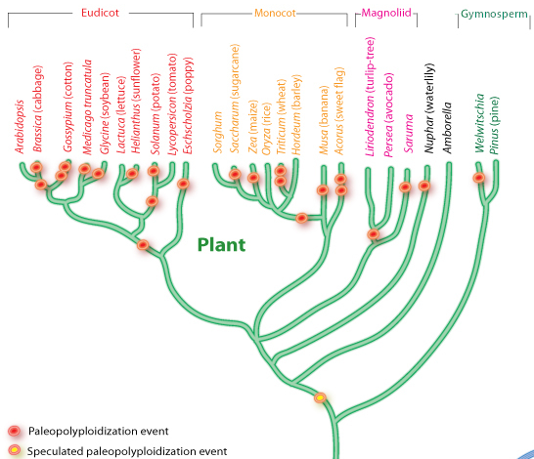
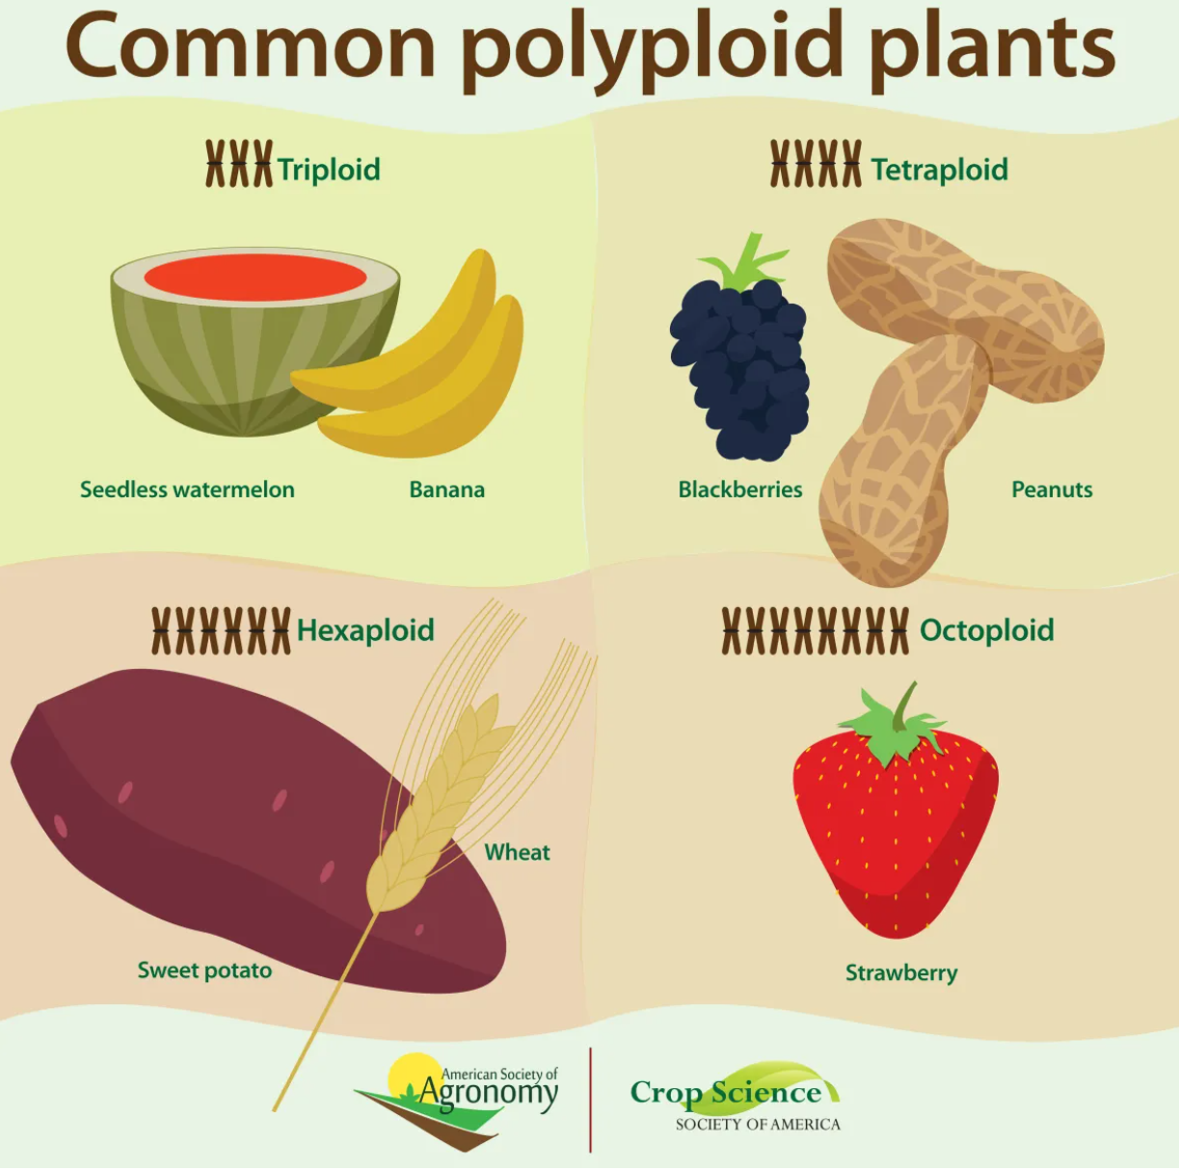
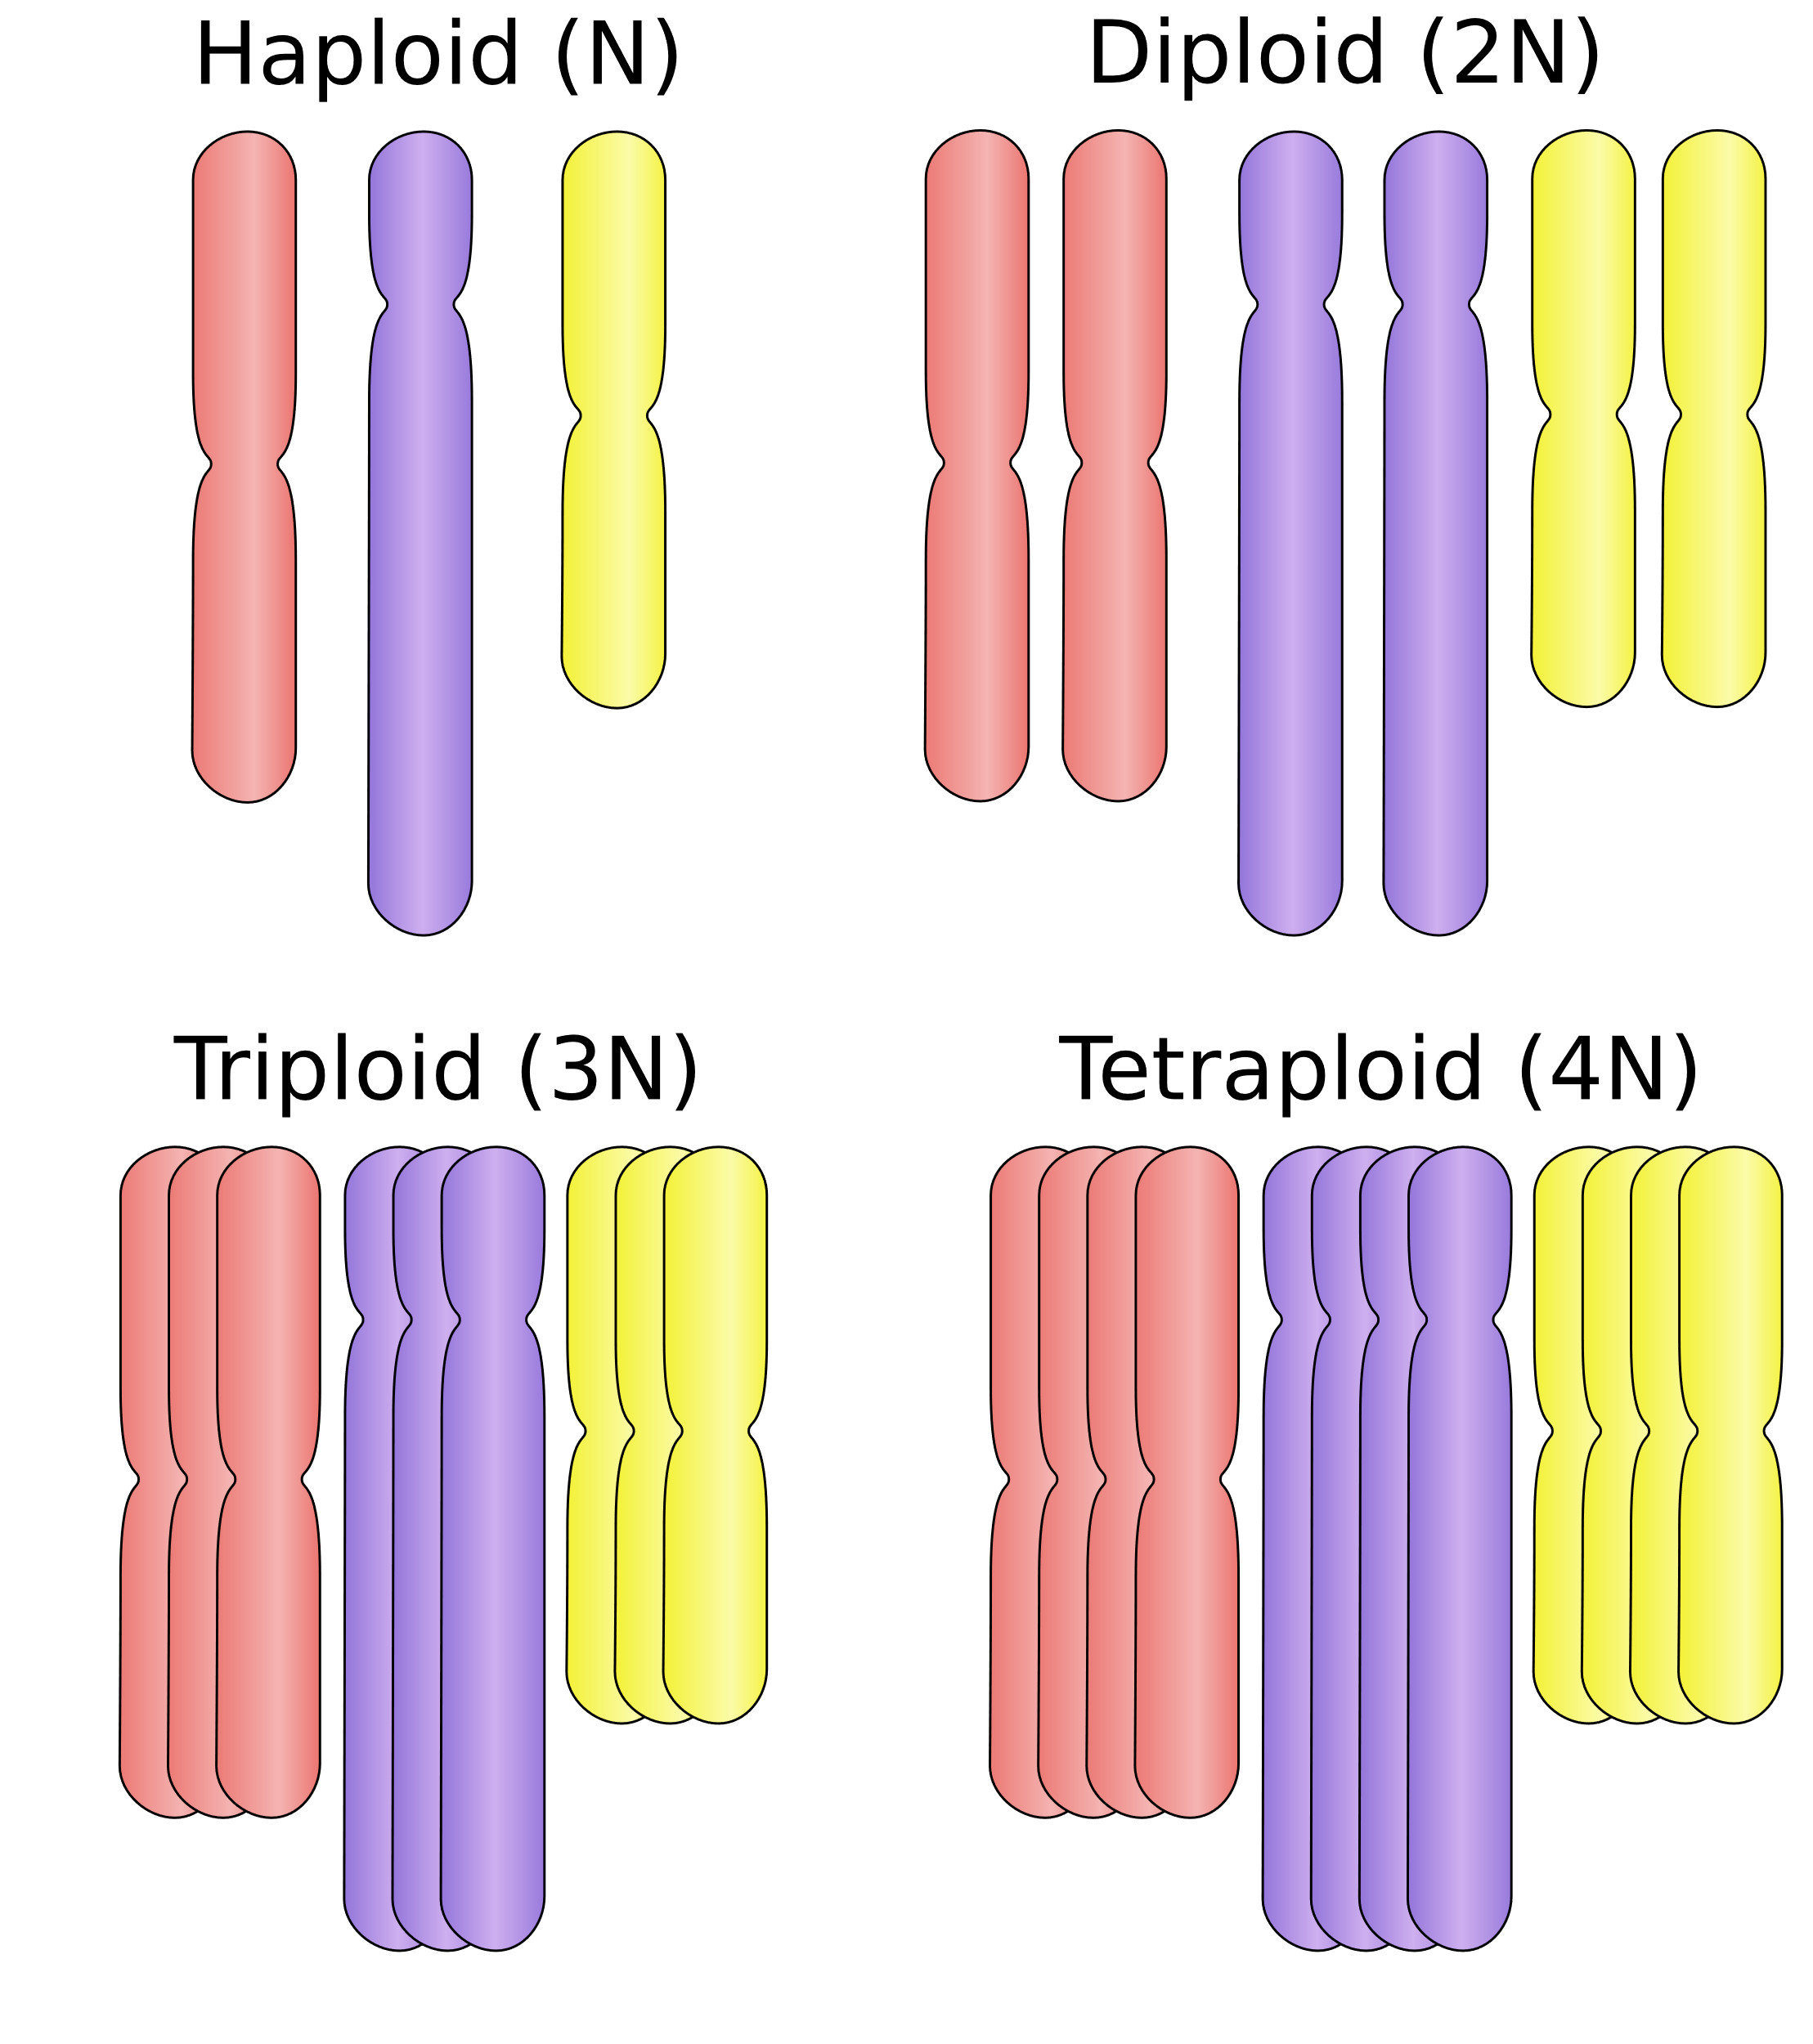
Polyploid genomes: more haplotypes to resolve
© Adapted from Galaxy Training Network, Cormier, Leroi et al., 2023, licensed under Creative Commons Attribution 4.0 International License

Slide 32
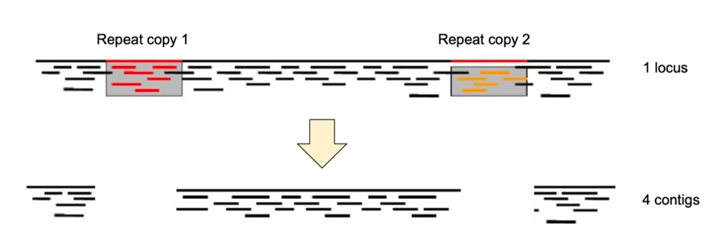
Repeated DNA: unresolved assemblies
?
?
© Adapted from Galaxy Training Network, Cormier, Leroi et al., 2023, licensed under Creative Commons Attribution 4.0 International License

Slide 33

Challenges of DNA sequencing and genome assembly
Big genomes
Heterozygous genomes
Polyploid genomes
Repeated DNA
Plant genomes are often big, heterozygous, polyploid, and rich in repeated DNA!

